Slide 1
PizzaSolution ピザソリューション
By: Rebekka
Notes:
Initial thoughts:
I’ve worked on something very similar before
Did not mess with the controllers much though and was mostly frontend
Used to the whole git-push
Unsure if I would be able to finish
Skipping explanation of structure because we all know it

Slide 2
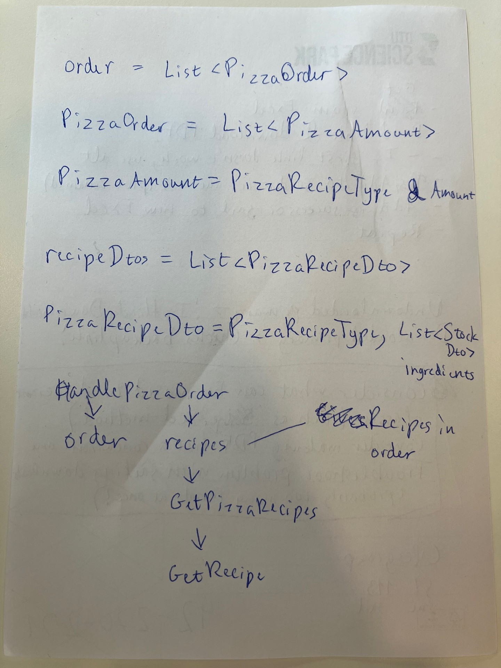
Early thoughts/problems
Not used to Visual Studio
Getting used to MSTest and mocks
TDD – what I did last project
Codebase lacking in code comments, so I wanted to make sure I made them for my new code
Throwing exceptions for the controller to handle – is that ideal?
Use existing methods in the fake repositories and database
Relationship between order, recipe and stock was confusing

Slide 3
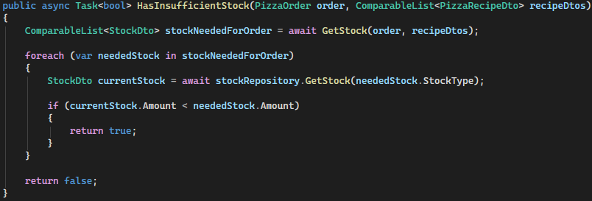
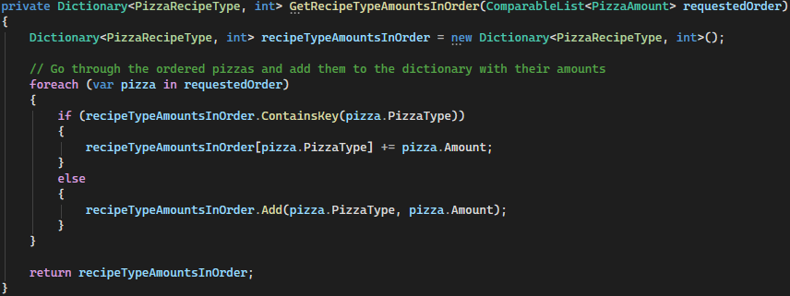
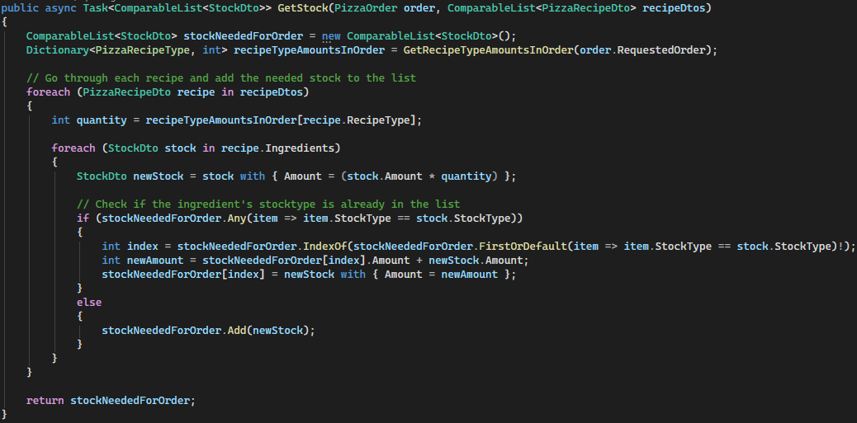
StockService
Notes:
First finished and working version of StockService
Order and recipes are clearly connected, yet they are separated

Slide 4
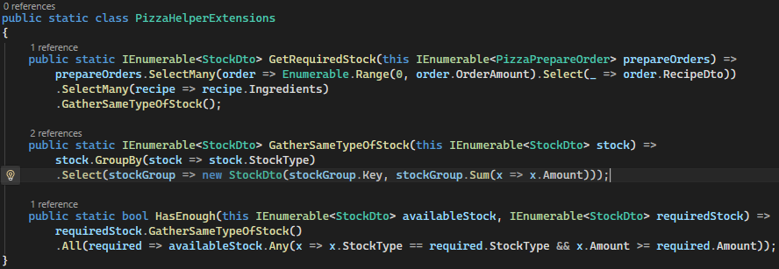
Notes:
RIP me
Only stumbled upon HasEnough in some prewritten test much later
Even had trouble finding this file for this powerpoint
This is why code documentation when handing over code is so important

Slide 5
Morten’s advice
Ideal code is written so that it doesn’t need comments (so try to write less of them)
Perhaps take the time to learn LINQ
The giant revolving pizza oven is terrible to implement, so can move on to other stuff if I want
The code is meant to make you pull your hair out
What I decided after:
Making the giant revolving pizza oven pass the tests will take a long time, so would rather focus on other stuff
Want to implement the helper functions into my code
Want to learn LINQ and get rid of as many foreaches as possible
Maybe get back to the oven
If I have time, add database
Notes:
Had reached part 4 of the assignment, i.e. the ovens, when I had my conversation with him

Slide 6
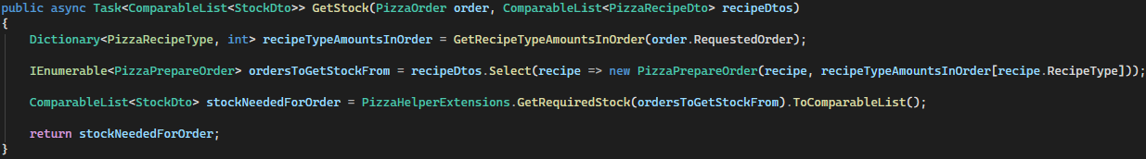
StockService 2.0
Notes:
Using the helper functions was worse for HasInsufficientStock and my helper function GetRecipeTypeAmountsInOrder:
When trying to give GetRecipeTypeAmountsInOrder the GatherSameTypeOfStock-method from PizzaHelperExtensions, I ended up with a triple-nested foreach loop that I had to turn into a LINQ. Which was way less effective than the dictionary I had already made. And adding things to a dictionary with a LINQ was apparently slower than just doing it normally.
My normal foreaches were better than the alternative because in order to convert into the format the helper functions wanted, foreaches were needed
Really cut down GetStock
Didn’t do much LINQ outside this, because…

Slide 7
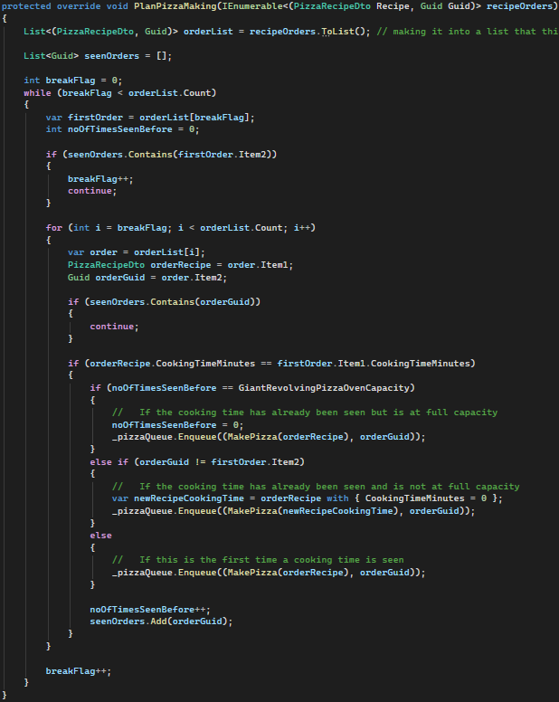
Back to the oven…
Idea:
Make alternate version of Michael’s
Make the first element have the correct cooking time, set rest to 0
Manipulating cooking time worked with the Assembly Line Oven, so why not this?
Problem:
Only works with 100 pizzas testcase
Different cooking times can be in the oven at the same time
Also feel like I definitely can get rid of that while-loop
Notes:
Basic idea is that it needs to add pizzas to the pizzaQueue

Slide 8
Perhaps order that list?
Insert Empty pizzas with 0 cooking time to fill up batch?
Divide into Batches?
Insert Empty pizzas with equal cooking time to fill up batch?
Give last element cooking time?
Make it wait for entire batch before proceeding?
A combination???

Slide 9
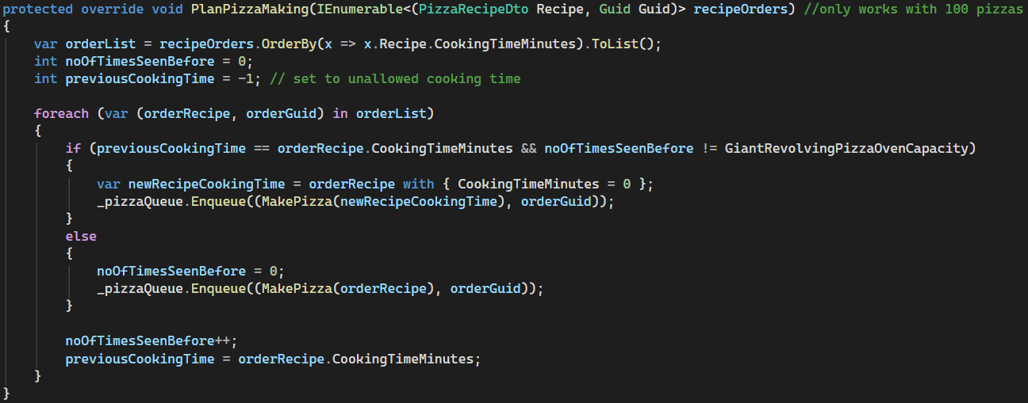
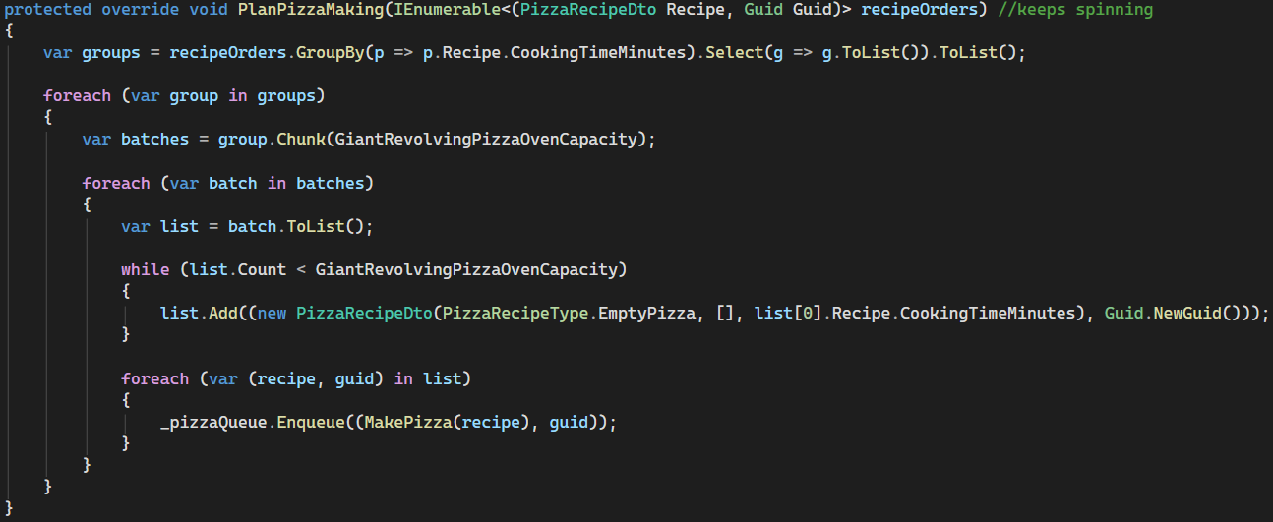
The ones that should work (both work as expected when debugging)
Kind of epitome of what I could come up with on my own
Doesn’t work → Still allows for cooking of different cooking times at the same time
Suggested by Copilot
After I remembered Morten’s advice to give it empty pizzas
Keeps running → Making all these empty elements for the program to handle makes it weird
Notes:
They work as expected when debugging, meaning that the problem arises somewhere else, i.e. when the queue gets dequeued
Inserting the Normal Pizza Oven’s code makes more tests pass than these two
Tried to make one that would handle orders in batches but it fails all tests, didn’t have time to debug and see what goes wrong

Slide 10
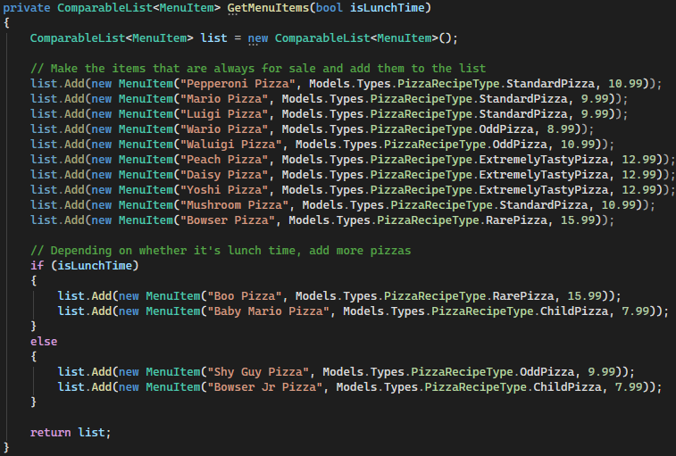
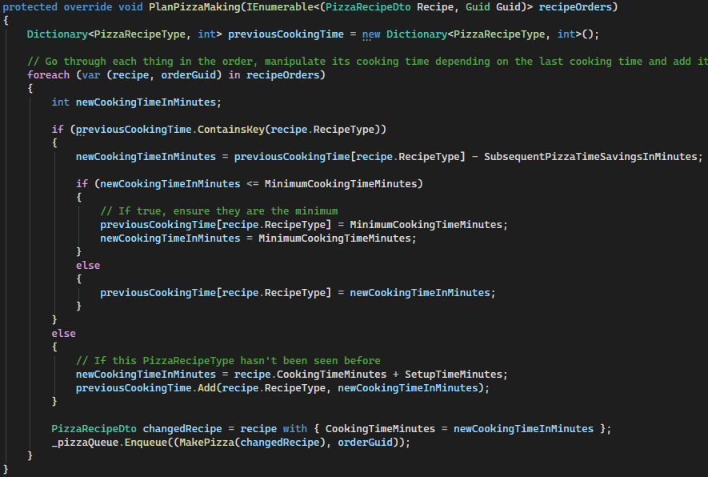
Final Thoughts
Things were pretty good until the Giant Revolving Pizza Oven → I should’ve just skipped it
Could have studied LINQ some more
Working with code made to be frustrating can be frustrating – but also rewarding
Was good to get back to a debugger – had been a while
Would’ve liked to have gotten to the database and some frontend
Notes:
I didn’t really have time to seriously consider skipping the oven because of job interview stuff, so instead I worked at it when I probably shouldn’t have or should’ve asked for help

Slide 11
Questions 質問
Thank you for listening
(hopefully I didn’t yap too much)

